Slide 1
Product Extensibility architecture
Paul Nerger
VP, Digital Exchange

Slide 2
What does this mean to Blue Prism products
Our products are designed to allow our customers, partners, and employees extend the product functionality and then post it on the DX for sharing
Each product utilizes a package manager that allows extensions to be:
Placed into packages for installation, update, and removal from the target product
Packages can be published on repository (i.e., the DX) for
Searching
Browsing
Viewing
Download and install
Installed packages are held in the product for package management
ex·ten·si·bil·i·ty /ikˌstensəˈbilədē/
noun - the ability to be extended or stretched.
"this process considerably diminishes the extensibility of the material“
COMPUTING
the quality of being designed to allow the addition of new capabilities or functionality.
"the software has been written from the ground up for extensibility and customization“
Source: Oxford English Dictionary

Slide 3
How do products offer extensibility?
Host Blue Prism Product
Blue Prism Product SDK
OR
Generate the extension files from product export or an SDK
Blue Prism Package Manager and integrated DX To support ANY Blue Prism Product
Provide a method for creating the Extensions such as an SDK
Leverage the Package Manager DLL and API
to create and publish packages
Explore and find packages
Download and install packages
Update Packages
Remove Packages
Add Package Meta-data then Zip everything together into a package
Submit the package to the DX for distribution
Blue Prism DX 2.0
Web Explore, View, Download with browser and a side load
Integrated Explore, View, Download and install
Target Blue Prism Product

Slide 4
What extensions should each product offer?
Examples of potential extensions
Automate | Interact | Capture | Decipher | Service Assist
Processes VBOs Code Stages WebAPIs SOAP APIs Alternative API schemas and protocols Alternative UIs UI buttons and functions DLLs | Off-the-shelf forms Channels (web, slack, teams, etc.) | Integrated Process Mining Tools Updated formulas for rating projects Alternative UI Alternative display methods Integration into project management tools Process Studio Generator | Alternative OCR engines Alternative document classifiers Alternative document extractors | Alternative Call Managers Alternative channels such as Slack, Twitter, and Facebook Alternative Database Connectors such as Oracle or DB2 Off-the-shelf connectors to standard systems such as Service Cloud
It depends upon the product!
Which extensions are allowed for a is up to product management
But the common Blue Prism package manager is used to create, distribute, install, and manage the packaged extensions
Black is available today; Grey is potential in the future.

Slide 5
The Package Manager – the heart of extensibility
Creator
Blue Prism Package Manager
Project written in Blue Prism Product or SDK
DX 2.0
Browse/Install
Publish
Package (containing one or more deliverables)
Filter
DLL
Build/Pack
DLL
DX Private 2.0
Blue Prism Product
Browse/Install
DLL
Consumer

Slide 6
How do we build DX 2.0 quickly and efficiently?

Slide 7
Blue Prism DX V2.0
Integrated with a flexible package manager that can install anything
Ability to create a package using GitHub
Ability to approve a package
Legal Approval
Marketing Approval
Technical Approval
Ability to create a NOSQL database of packages
Ability to search and browse the metadata files held in the packages
Ability to display the package Meta-data as a Card or as a detailed page
Optional - Ability to create an on-premise DX Private that can replicate packages from the Central DX
Major features and functions

Slide 8
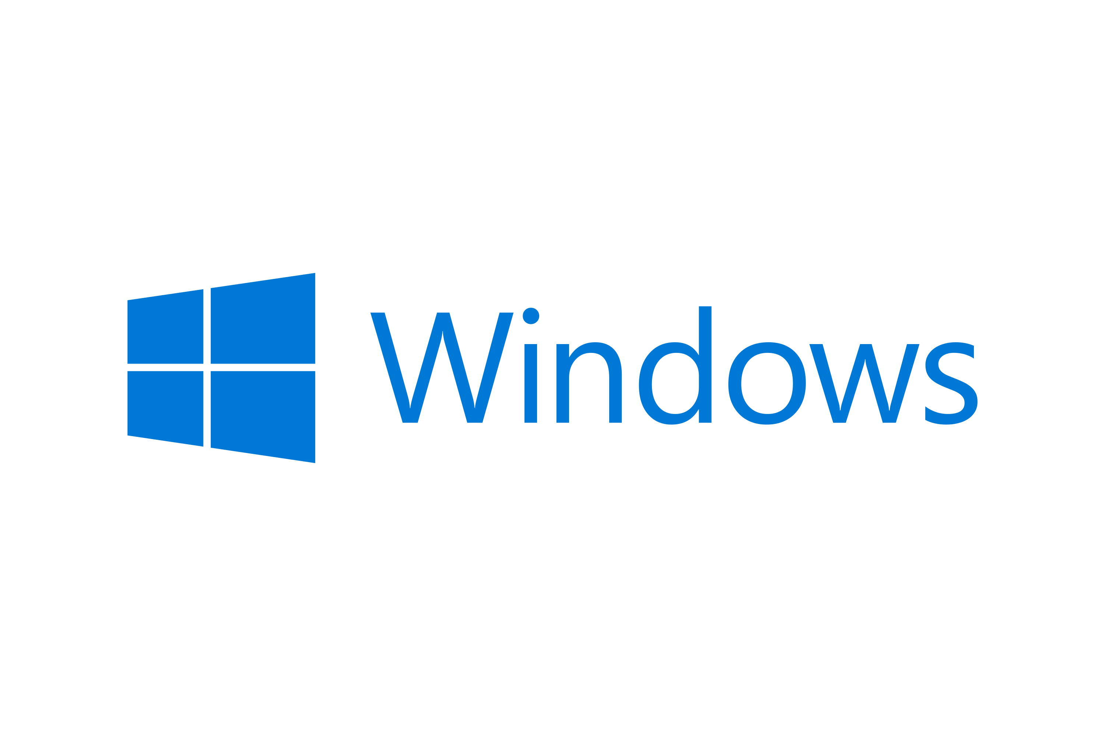
Which Open Source Should we leverage?
Platform
Package Manager
Late to the Package Manager game, Microsoft developed NuGet as a package manager for extending .NET and Visual Studio.
Taking NuGet as a foundation, Chocolatey Software, built the open source group Chocolatey that extended NuGet for Windows
Using Chocolatey as a foundation, we can build our Package Manager based upon Apache 2.0 License – Approved by Legal
Blue Prism Package Manager V1.0

Slide 9
What’s in a Blue Prism package?
Blue Prism package – a zip archive
Metadata – XML using the NuGet format extended for our purposes
Tile, Version, and Description
Secure Signature
Dependencies on other packages
Software and content file manifest
Where each software and content file should be copied
Metadata about the Package – .nuspec format
Description of the Extension
Dependencies on other Packages
The software files and content files required for the extension to operate
Windows PowerShell Scripts to
Install
Upgrade
Remove
Software files
Content files
Install, Upgrade, Remove scripts

Slide 10
What are the Four file types in a Package?
Blue Prism package – a zip archive
Metadata – XML using the NuGet format extended for our purposes
Tile, Version, and Description
Secure Signature
Dependencies on other packages
Software and content file manifest
Where each software and content file should be copied
Required - Metadata file describes the package
Optional - Software files are executable and DLLs that need to be positioned in the target system
Optional - Content files are supporting files such as HTML and CSS
Optional - Scripts are Windows PowerShell scripts that are run to perform different
Software files
Content files
Install, Upgrade, Remove scripts

Slide 11
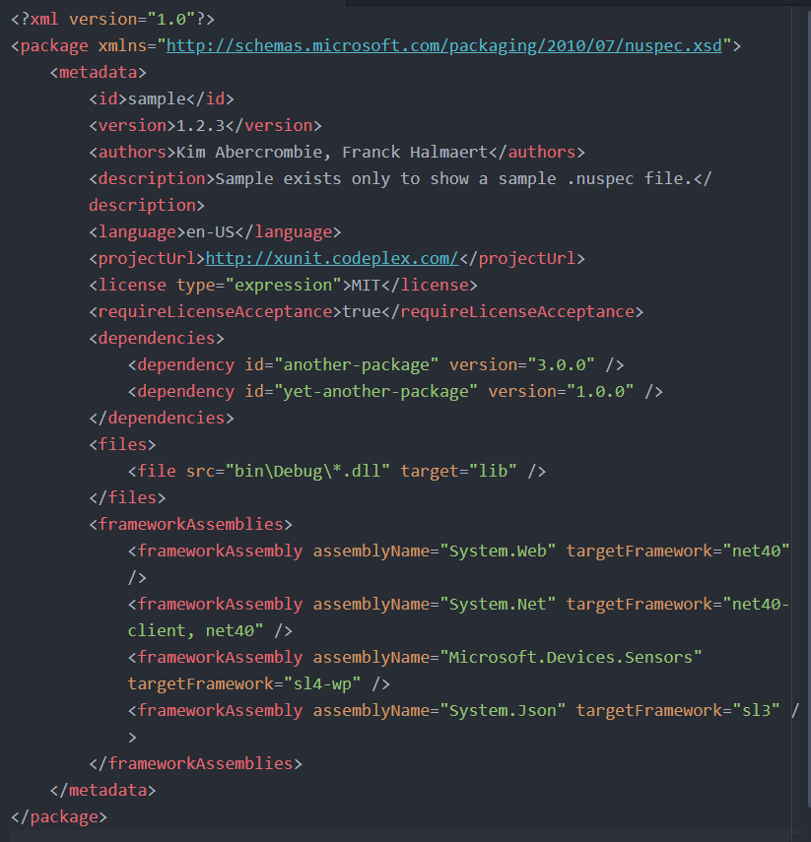
What does Metadata look like?
Based upon the .nuspec XML descriptor an open source format from Microsoft and extended by Chocolatey
Then extended by Blue Prism to accommodate new package features:
Signing of the package by Blue Prism
Optional signing of packages by customers for DX Private
A License Management Facility (LMF) to license the packages content

Slide 12
How does the DX V2.0 Work?
Reference App for building in the Package Manager
DLL with CRUD methods for Packages
API for Search, Download, and Execute Packages
Meta-data is no longer held in a Relational Database but a Not Only SQL Database (NOSQL)
Packages are submitted to the DX where they are indexed by the NOSQL database
Metadata is held in the packaged .nuspec file
The DX knows how to search and filter packages based upon .nuspec file
DX APIs know how to return metadata based upon GraphQL APIs
NOSQL Database such as MongoDB
Local DX
Remote DX
Package A
PackageD
Package F
Package A
Package B
Package C
Package G
Package D
Package E
Package F
Package G
Package H
Package I
DX 2.0 with Integrated Package Manager

Slide 13
Key Security Issues
Package Trust
All public packages on the DX are scanned using a Digital Worker that flags malware and potentially dangerous software
The Digital Worker also checks to manifest against the package content
All public packages on the DX are signed using an asynchronous key
Default action is to only install packages that are properly signed by Blue Prism
Optional – issuing of certs to DX Private customers allowing them to sign their own packages
IP Protection
The package manager will be extended to add a License Manage Facility (LMF) specifically for extensions
Licensed extensions will be wrapped in the LMF using DLLs
The LMF will read license files that are distributed independently of the package
The LMF will support basic license concepts of
Term Licensing
Perpetual Licensing
Concurrent Use licenses
How do customers know that the package can be trusted?
How can partners protect the IP that is in their packages?

